Slide 1

Introduction to Computational Text Analysis
Prof. Sebastián Vallejo Vera

Slide 2
Who am I?
(All questions about my personal life are fair questions right now--and only now)

Slide 3
My first names is Sebastián; my last names is Vallejo Vera.
  You can call me however you feel more comfortable: Sebastián, Professor Vallejo, Professor Vallejo Vera, Dr. Vallejo, and/or Dr. Vallejo Vera. Dr. Vera is my mom.
I received my PhD in 2019 from the University of Maryland, College Park (just like Dave). I am a comparativist and a methodologist.
Reach me at:
  sebastian.vallejo@uwo.ca
  www.svallejovera.com

Slide 4
My Research: Text Analysis
Application of Large Language Models (LLM) in the social science:
  Timoneda, Joan C., and Sebastián Vallejo Vera. "BERT, RoBERTa, or DeBERTa? Comparing Performance Across Transformers Models in Political Science Text." The Journal of Politics 87, no. 1 (2025): 347-364.
  Timoneda, Joan C., and Sebastián Vallejo Vera. "Rolling Memory: A New Approach to Annotation with Generative LLMs in Social and Political Research”. Chinese Political Science Review (Forthcoming)
  Davila Gordillo, D., J.C. Timoneda, and S. Vallejo Vera. “Machines Do See Color: Using LLMs to Classify Overt and Covert Racism in Text”. Sociological Method and Research (Forthcoming).
  Timoneda, Joan C., and Sebastián Vallejo Vera. "Behind the mask: Random and selective masking in transformer models applied to specialized social science texts." PloS one 20, no. 2 (2025): e0318421.
  Vallejo Vera, Sebastián, and Hunter Driggers. "LLMs as annotators: the effect of party cues on labelling decisions by large language models." Humanities and Social Sciences Communications 12, no. 1 (2025): 1-11.
Human-LLM interactions:
  SSHRC IDG: “LLMs, Rabbit Holes, Echo Chamber, and Bias”.

Slide 5
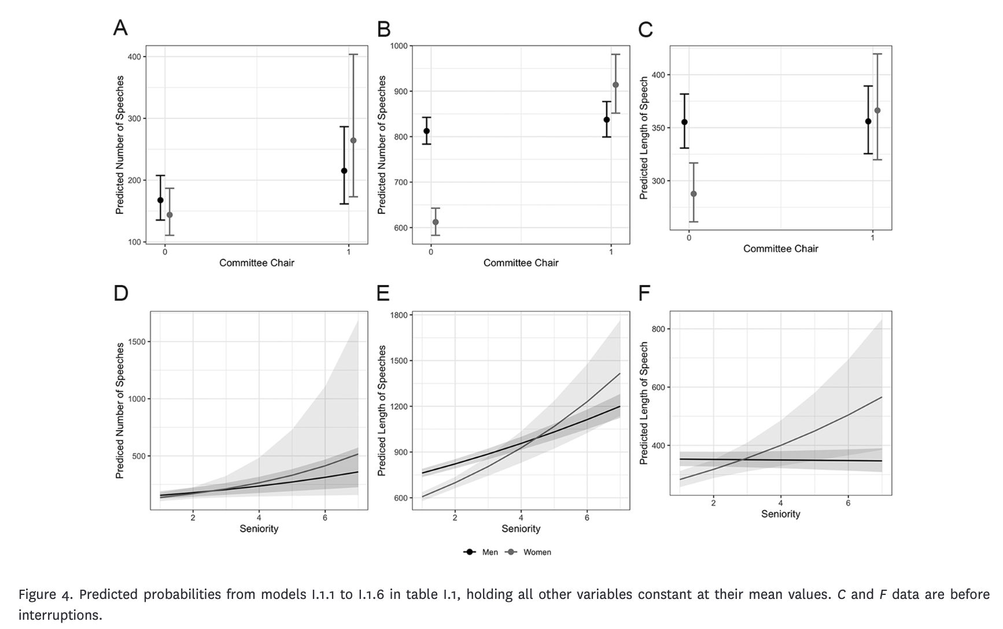
My Research: Gender and Politics
Vallejo Vera, S., & Gómez Vidal, A. (2022). The politics of interruptions: gendered disruptions of legislative speeches. The Journal of Politics, 84(3), 1384-1402.

Slide 6
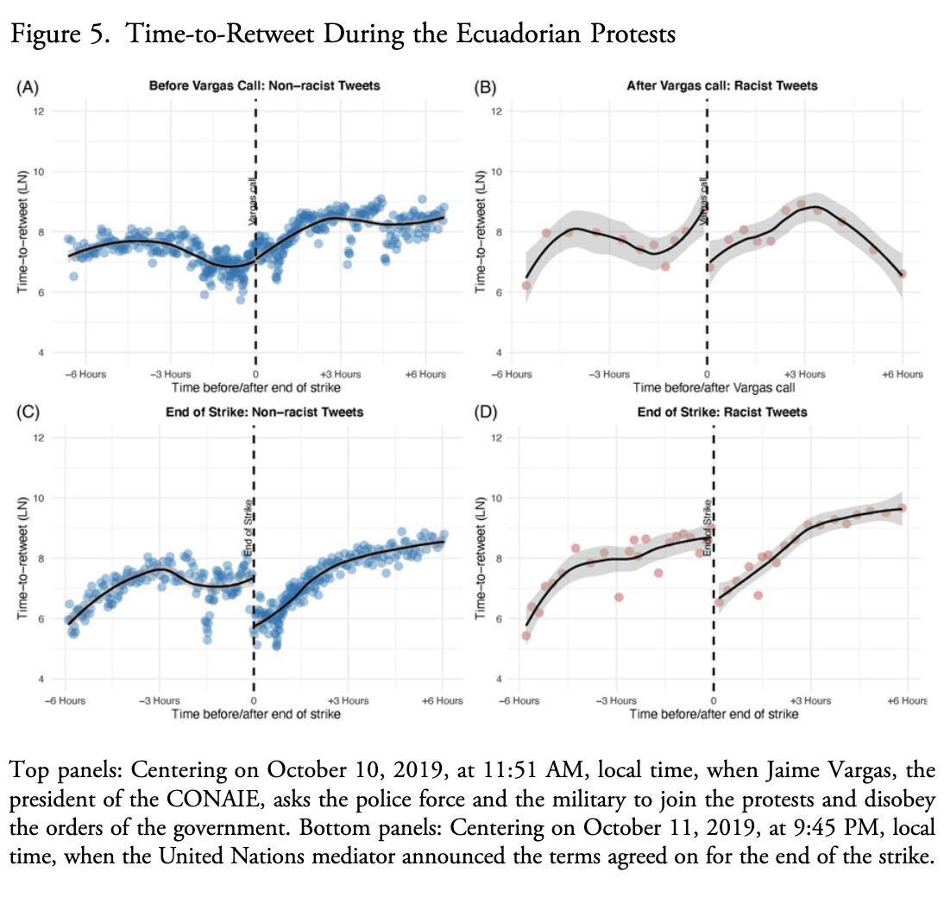
My Research: Racial Identity and Politics
Vallejo Vera, S. (2023). Rage in the Machine: Activation of Racist Content in Social Media. Latin American Politics and Society, 65(1), 74-100.

Slide 7
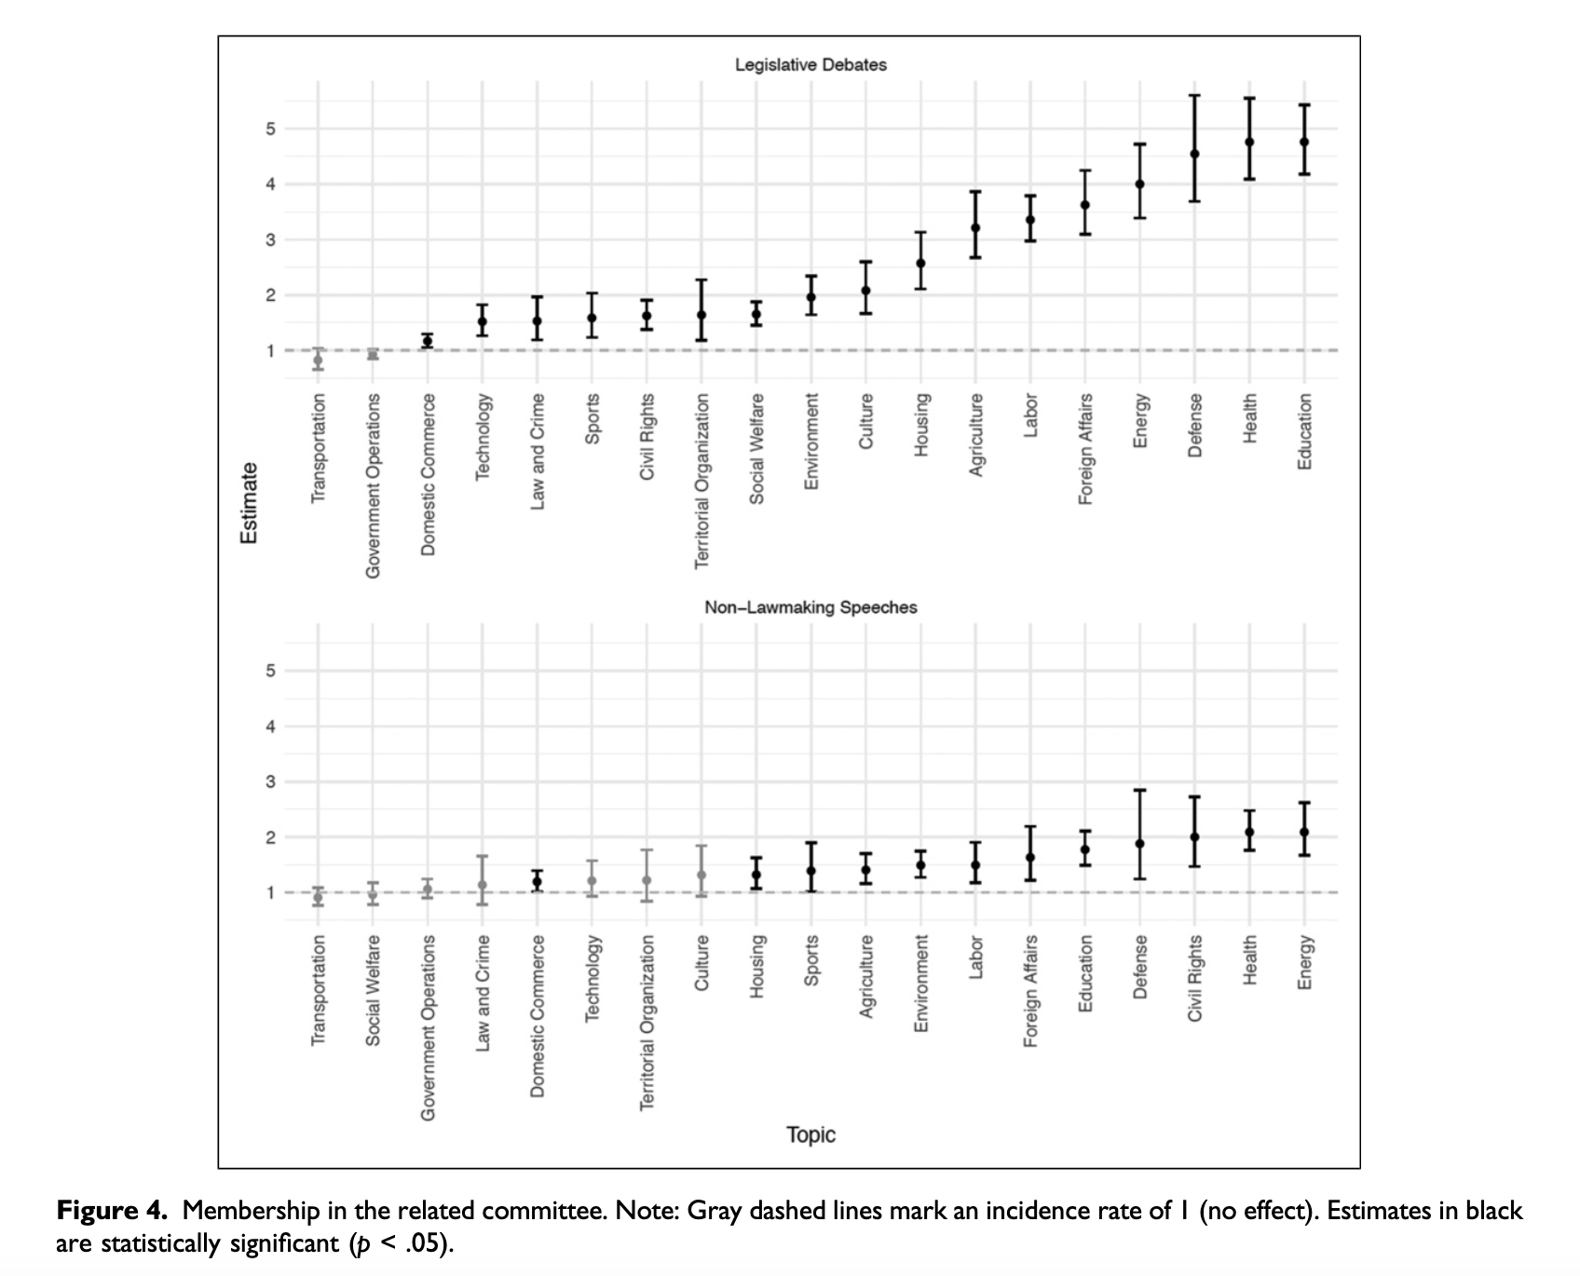
My Research: Legislative Politics
Alemán, E., Micozzi, J. P., & Vallejo Vera, S. (2023). Congressional Committees, Electoral Connections, and Legislative Speech. Political Research Quarterly, 76(2), 994-1011.

Slide 8
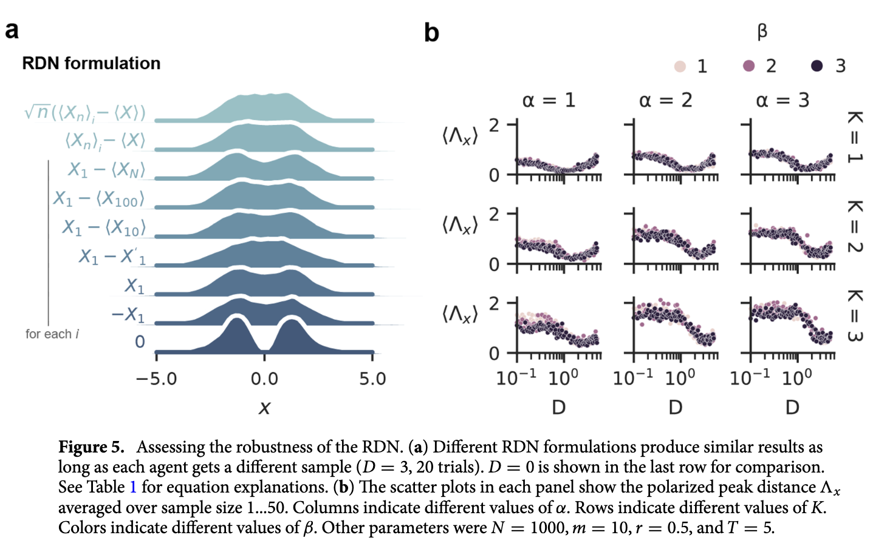
My Research: And then some…
Currin, C. B., Vallejo Vera, S., & Khaledi-Nasab, A. (2022). Depolarization of echo chambers by random dynamical nudge. Scientific Reports, 12(1), 9234.

Slide 9
Questions?

Slide 10
Who are you?

Slide 11
Name
Research Interest / Policy Interest
Why are you taking this course?
What is you R/Python/coding level?

Slide 12
Course Organization

Slide 13
FAQs:
Must I be on time? Yes.
Can I come into the class if I arrive late? Yes, but quietly.
Must I come to class? No.
Do you want me to come to class? Should I come to class? Yes, and YES.
Will you grade class participation? No, but I want you to participate regardless.
Will all the slides and material for the class be made available to me? Yes!

Slide 14
Expectations during Class
Be kind.
Be respectful.
Avoid looking at your phone…

Slide 15
Course Website
As with previous iterations of this course, all of the material, and all of the information about assignments and submissions will be in the course website. The previous course website was this one: https://svallejovera.github.io/cpa_uwo/.
I am currently working on an updated version of the course, one that reflects the latest advances on text analysis, as well as changes on what is covered (and how it is covered).
I will build the website as the course progresses. As soon as I have the landing page up and running, I will send you the link.
That old site is not maintained, but it still has a lot of valuable information and code (and there will be big overlap in the content, specially from the first 5 weeks).

Slide 16
Course Readings
There are weekly readings. I will be referencing the readings throughout the lecture, so it is best if you have them done by Monday. You are encouraged to ask questions about the readings, (particularly about the text analysis part of the substantive pieces).
All the readings are available in Perusall. You can access Perusall through OWL by clicking on the Content tab.
By the end of the week, I should have every reading with its proper due date in Perusall. However, the information for the readings is in the Syllabus, so no need to rely solely on Perusall.

Slide 17
For all weeks, there are two types of readings: technical and applied.
  For most weeks, the technical reading will be a chapter from Grimmer, Roberts, and Stewart’s book “Text as Data: A New Framework for Machine Learning and the Social Science”.
Mini-FAQ:
  Should I do all the readings? Yes.
  Should I do all the readings before class? If possible. However, some can be more challenging than others. I recommend that, at the very least, you carefully read the technical readings and one applied paper. If you run out of time, skim the rest and catch up when possible.
  Ok, but do I really need to do all the readings? Yes, this is why…

Slide 18
Read the Syllabus!
(also, you probably did not read the syllabus so when the class ends, please go read the syllabus)

Slide 19
Course Requirements
(This is how capitalism turns you into a number)

Slide 20
Homework (30%): There will be three worksheets that will walk you through the implementation of different text analysis techniques. At the end of each worksheets, you will find a set of questions. You should partner up with someone else in your class and go through these together (even though the submissions are individual).
Replication Exercise (30%): You will be carrying out the replication of a paper. Further instructions can be found in the syllabus (and the course website).
Final Essay (40%): A 4000-word max essay. Further instructions can be found in the syllabus (and the course website).

Slide 21
Code

Slide 22
This is a code-heavy, math-heavyish, course.
  You do not need to worry too much about the math, but having a working knowledge of matrices will go a long way.
  This is a computational text-analysis course. No need to be an expert coder, but you need an understanding of R (and/or Python) to take advantage of the material.

Slide 23
LLMs in class?
LLMs (e.g., Claude, ChatGPT) can be amazing tools for research.
LLMs are pretty good at providing code (if you know what you need and understand what you get).
We will be studying how LLMs work (META!), but you might also be tempted to use them for your coursework.
We will be talking about this more in detail in the last weeks of the course, but for now…

Slide 24
Office Hours
(Do not suffer in silence)

Slide 25
Mondays from 12:00PM to 1:00PM or by appointment. Mostly by appointment.
You should come to office hours…

Slide 26
Closing remarks

Slide 27
I do not believe in punitive teaching. I believe that learning happens in community.
If you have questions, ask them. More often the not, other students have similar questions, so it helps everybody.
This program (and by extension, this class) is preparing you for a job/a PhD. Take advantage of it. It’s tough out there.
  If you are a PhD student, this is you job!

